Slide 1
Fault detection in software using Biological Techniques
Group Members:
Asif Sharif Akash (ID: 20-42647-1)
Tarek Hossain (ID: 20-43018-1)
Md. Yeasin Rahat (ID: 20-43097-1)

Slide 2
Outline:
Introduction
Biological Techniques
Methodology & Analysis
Proposed Algorithm
Flowchart
Simulation Result
Work Schedule
Reference

Slide 3
Introduction
Software testing and maintenance phase to assure software quality
Software changes on demand and modification
Literature Survey of Xiaoxing Yang on Learn-To-Rank(LTR)
LTR may detect the fault but interface design is not included at his proposal

Slide 4
Problem Statement
Introduction:
Boltzmann Learning is only used to detect software quality and efficiency.
No interface design was introduced for Learn-To-Rank Algorithm to detect software faults.
Test cases using particle swarm optimization is limited to severe cases only.
Research Question
What issues have various testing methods employing biological technique resolved?
What are the advantages and disadvantages of various biological approaches used in software engineering?
What are the various validation methods for detection and prediction?

Slide 5
Research Objectives
Introduction:
To find the biological strategies for optimization
To identify the issue utilizing methods and procedures
To simulate and interpret the experimental data
Limitation of the study
The algorithm of LTR is limited to only software interface design
Test cases more than 10 cannot have appropriate results of showing faults
Boltzmann method may give the idea of global energy to sustain the approach but lacks in LTR sometime.
Particle swarm optimization limits to genetic field only.

Slide 6
Biological Techniques
Fingerprinting
Procedure duplication
Error detection by duplicated instructions

Slide 7
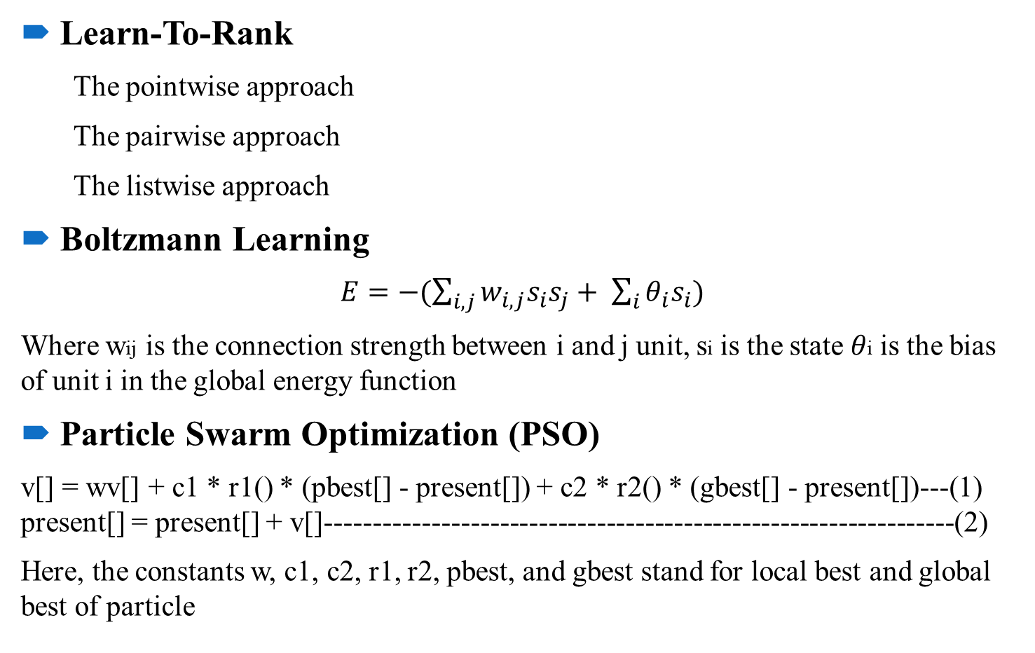
Methodology & Analysis
Learn-To-Rank
The pointwise approach
The pairwise approach
The listwise approach
Boltzmann Learning
$E=−(\sum_{i,j}{w_{i,j}s_{i}s_{j}+ \sum_{i}{θ_{i}s_{i})}}$
Where wij is the connection strength between i and j unit, si is the state 𝜃i is the bias of unit i in the global energy function
Particle Swarm Optimization (PSO)
v[] = wv[] + c1 * r1() * (pbest[] - present[]) + c2 * r2() * (gbest[] - present[])---(1) present[] = present[] + v[]-----------------------------------------------------------------(2)
Here, the constants w, c1, c2, r1, r2, pbest, and gbest stand for local best and global best of particle

Slide 8
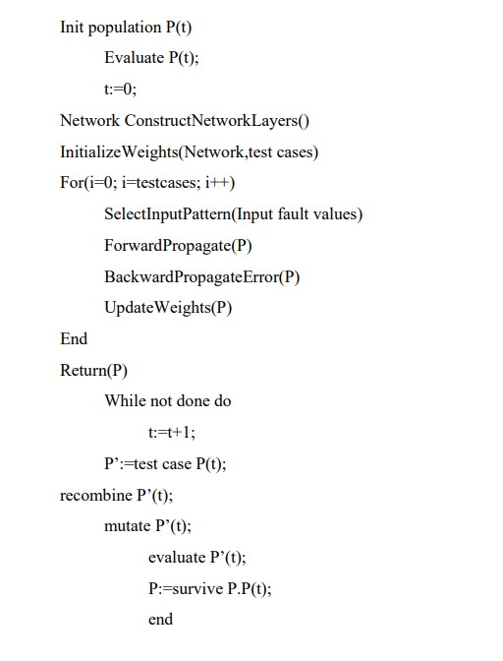
Proposed Algorithm

Slide 9
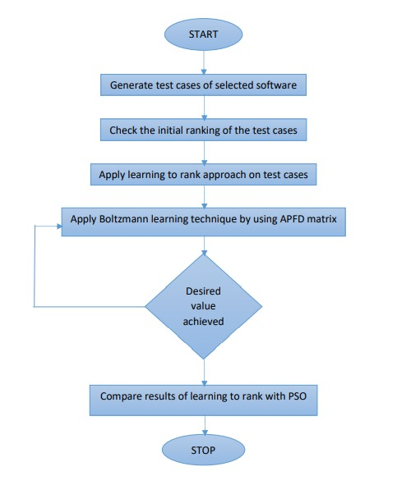
Flowchart

Slide 10
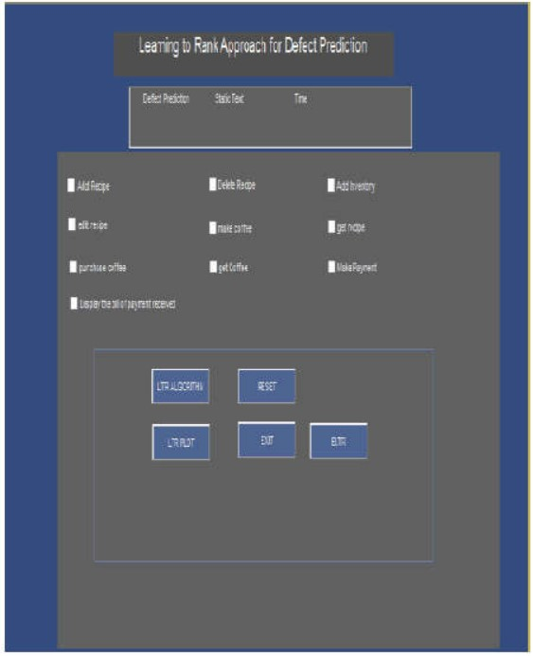
Simulation Result
Attributes | Values
Number test cases | 10
Repeated test cases | No
Fault in the Test cases | Yes
Number of application | 1
Interface designed by algorithm

Slide 11
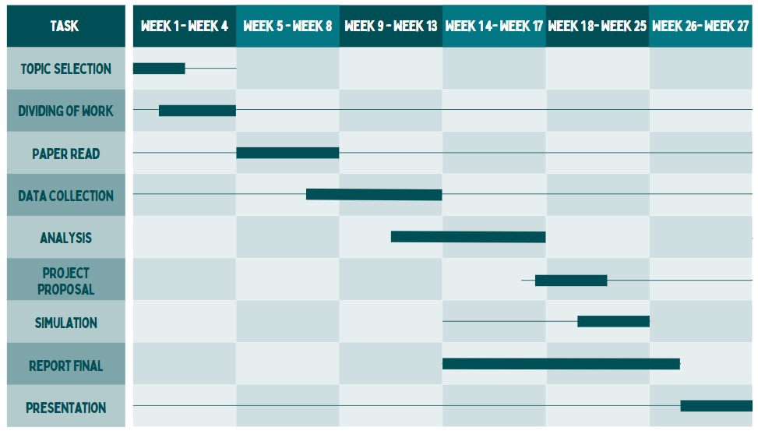
Work Scheduling

Slide 12
Reference
[1] S. S. JAGATJOT SINGH, "FAULT DETECTION TECHNIQUE FOR TEST CASES IN SOFTWARE," International Journal of Advances in Electronics and Computer Science, vol. 4, no. 8, pp. 2393-2835, 2017.
[2] B. D. Cagatay Catal, "Investigating the effect of dataset size, metrics sets, and feature selection techniques on software fault prediction problem," Information Sciences, p. 1040–1058, 2009.
[3] P. R. Sushant Kumar, "A Comprehensive Analysis for Software Fault Detection and Prediction using Computational Intelligence Techniques," International Journal of Computational Intelligence Research, vol. 13, no. 1, pp. 65-78, 2017.
[4] G. A. ·. A. Selamat, "A survey on software fault detection based on different prediction approaches," Vietnam J Comput Sci, vol. 1, pp. 79-95, 2014.
[5] C. B. ,. a. M. Y. Jiang Y., "Techniques for evaluating fault prediction models," Proc. Empiric. Softw, vol. 13, no. 5, pp. 561-595, 2008.

Slide 13
THANK YOU

